Slide 1

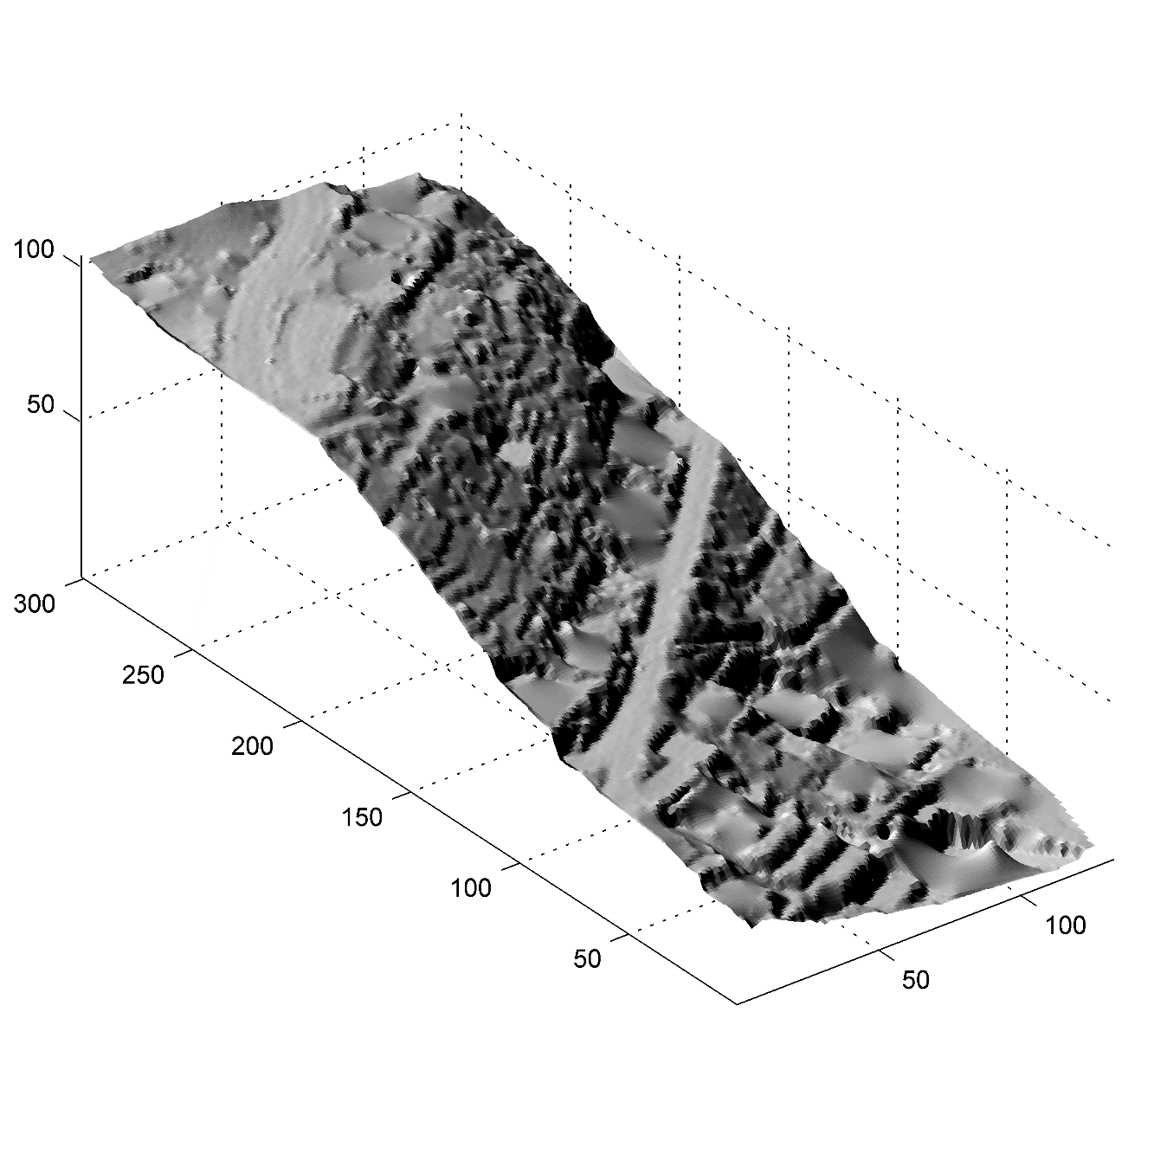
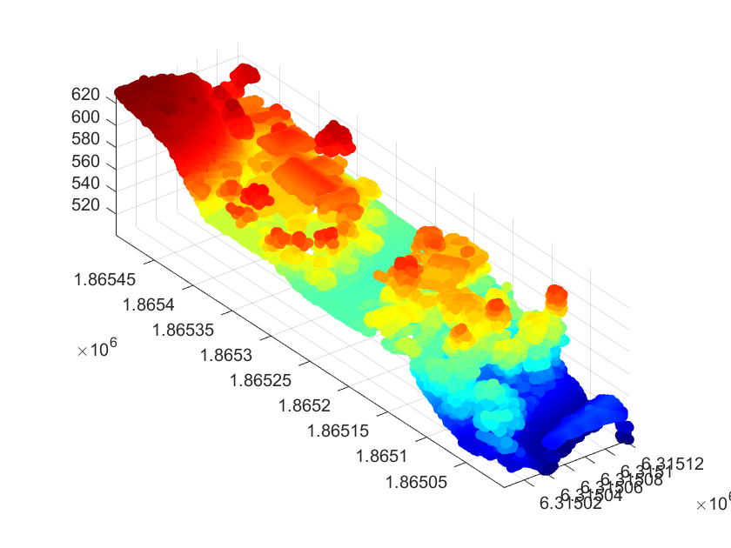
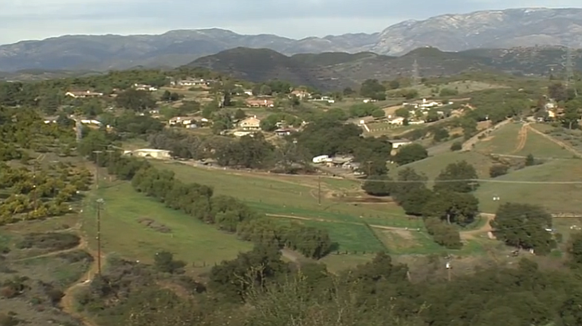
Morphological Filter for Terrain Classification of LiDAR Data
Anthony Song, Computer Science and Engineering, College of Engineering, Honor’s College
Xiaohui Yuan, Computer Science and Engineering, College of Engineering
BACKGROUND
METHODS
LiDAR (Light Detection and Ranging) technology and data is used to obtain a digital surface model. Through a series of machine learning algorithms, a DTM (digital terrain model) is obtained.
Generating a highly accurate DTM is a difficult, yet a rewarding feat. Ever since getting into computer science courses, I have been interested in diving into the machine learning field. Through generating a DTM, I am able to see my work visually. I feel satisfaction knowing that my work can be used in numerous applications such as simulating landslides and transportation planning.
The morphological filtering algorithm requires four parameters in addition to the x, y, and z Cartesian coordinates represented as a point cloud as in Fig 2.: the cell size (of ZI), slope (controls the Boolean classification of ground or object), vector of window size (manipulates each iteration of the program), and elevation value (finalizes the ground and object classification).
The filtering algorithm goes through a series of steps. Through the parameters, the algorithm outputs the minimum surface (ZI). The ZI is then processed and later identified whether if it is a bare earth or object value. The output is a vector of Boolean values for each Cartesian coordinate. Ground represented as 0 and object represented as 1.
After determining the Boolean values of ground and object, a digital elevation model (DEM) is finally generated from the gridded, altered x, y, and z points. The algorithm classifies and then removes the object values Multiple iterations are ran to ensure accuracy.
THESIS AND/OR HYPOTHESES
Figure 3. A rough estimated DTM generation of the terrain
LiDAR technology is used to create digital models of the terrain. The most commonly used LiDAR data set is point cloud. Multiple parameters within a ground filtering algorithm can be used against a point cloud data set to generate a DTM.
From a terrain sample such as in Fig 1. and its point cloud data from LiDAR technology, the point cloud must be transformed into a ground model that represents the terrain, buildings, and vegetation.
Numerous algorithms have attempted to categorize and distinguish the vegetation and buildings from the terrain with low accuracy. However, a morphological filtering algorithm can be tested against many different types of data while being the most efficient and accurate.
RESULTS AND DISCISSION - Continued
The results of this project and program are not the most accurate as of date. As seen in Fig 3. The morphological filter does not remove all buildings and leaves a few vegetation behind.
In the future, the algorithm and its parameters could be better optimized for higher accuracy and efficiency. It would also be beneficial to apply the program against other data sets which include varying landscape, buildings, and bodies of water.
BIBLIOGRPAHY/REFERENCES/WORKS CITED
Figure 2. Sample data input rendered as a point cloud
Pingel, T. J., Clarke, K. C., & McBride, W. A. (2013). An improved simple morphological filter for the terrain classification of airborne LIDAR data. ISPRS Journal of Photogrammetry and Remote Sensing, 77, 21-30.
Hui, Z., Li, D., Jin, S., Ziggah, Y. Y., Wang, L., & Hu, Y. (2019). Automatic DTM extraction from airborne LiDAR based on expectation-maximization. Optics & Laser Technology, 112, 43-55.
RESULTS AND DISCISSION (or EXPECTED RESULTS)
The data set the morphological filtering algorithm was against was the hillsides of San Diego, California as seen in Fig 1. Those areas contained diverse terrain with hills, forests, buildings, and occasional small bodies of water.
The algorithm’s parameters were set to default values with cell size (c) = 1, slope (s) = 0.2, window size (w) = 16, elevation threshold (et) and elevation scaling factor (es) set to 0.45 and 1.2 respectively. Results varied from more or less accurate based on altering the parameters’ default values and different point cloud input data.
A morphological filtering algorithm has the potential to generate true DTM, a plane with only the bare earth. As mentioned previously, a DTM many beneficial applications.
ACKNOWLEDGMENTS
UNT Office of the Provost
UNT Office of Research and Economic Development
UNT Honors College
UNT College of Engineering
UNT Computer Science and Engineering Department
Figure 1. Similar terrain from the hills of San Diego area taken for input data.

